Slide 1

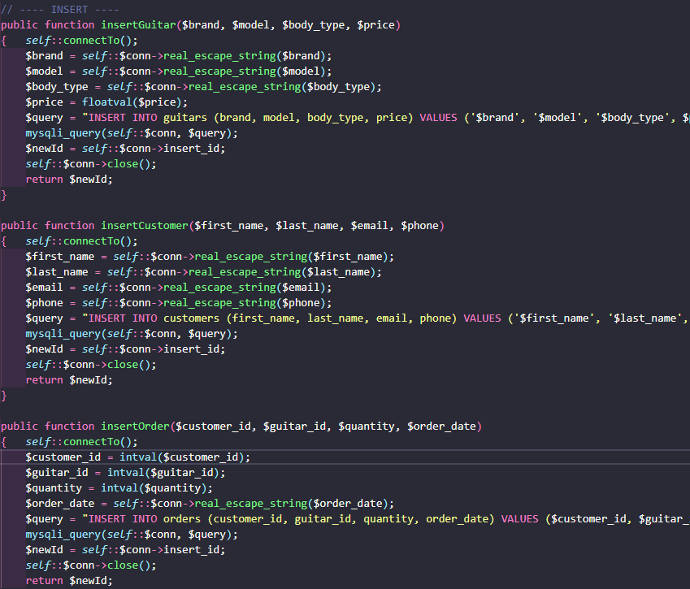

SCRUM 3
Guitar Shop CRUD
CIS 266

Slide 2
Team members & ROLES
Victoria Mayer – SCRUM Master, code review & polish, DB setup
Yacob Hiben – Foundational file structure and code, page styles
Amanda Mays – Coding support

Slide 3
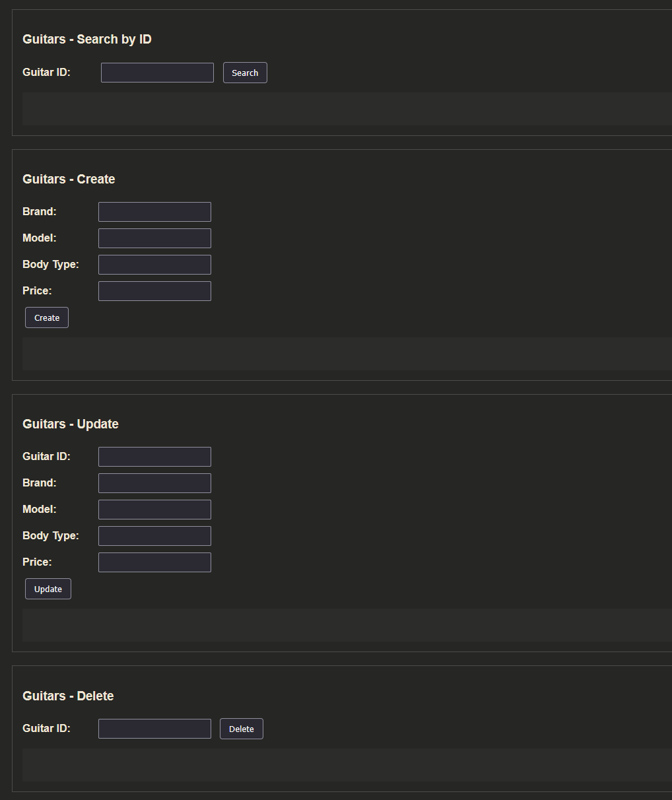
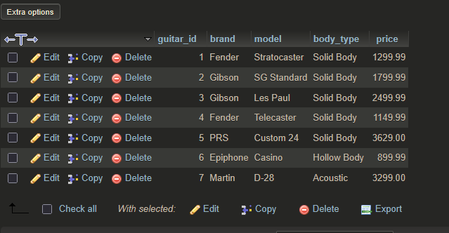
Project goals
Build a web service that supports CRUD
Use AJAJ, PHP and a MySQL database
Create a functional API with testers
Enable manipulation of data in the guitar shop DB

Slide 4
Approach
Sprint 1
Design and create database
PHP classes (guitar, customer, order, DB)
Sprint 2
API endpoint
API testers
Sprint 3
Client UI and design
CRUD for all 3 tables

Slide 5
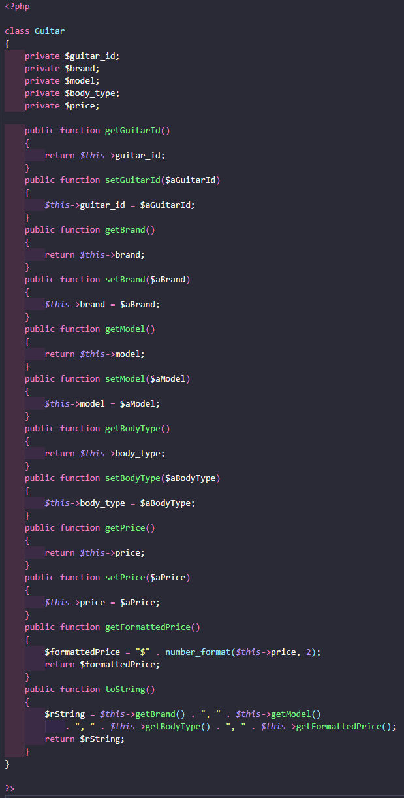
classes
Classes Guitar, Customer, and Order use similar structure

Slide 6
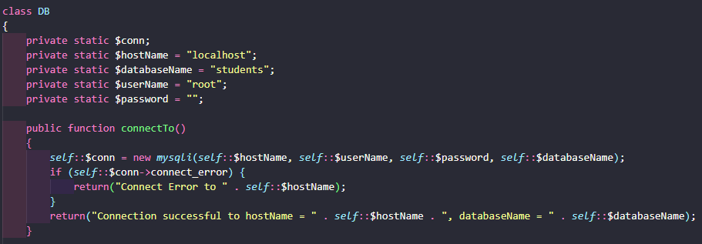
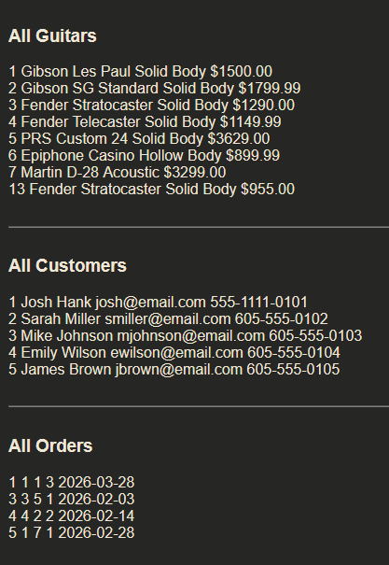
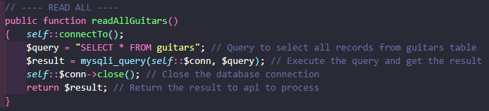
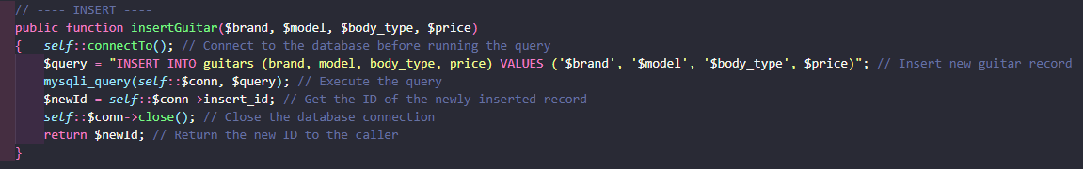
Db class
Creates connection
Contains methods to interact with MySQL tables
Follows pattern using mysqli_query

Slide 7
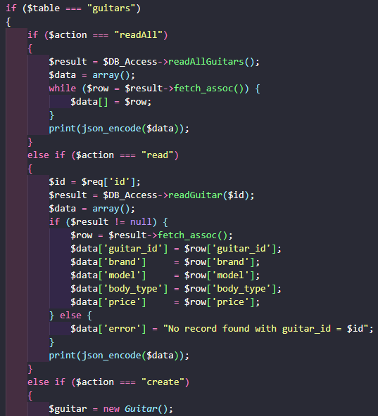
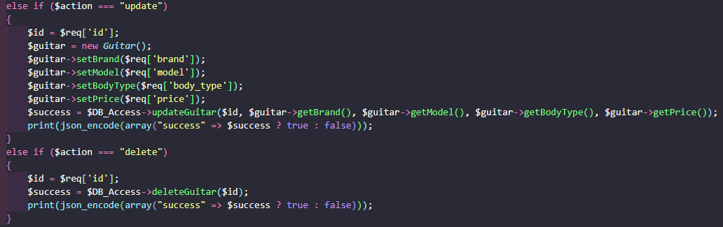
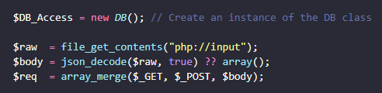
api
Takes request
Reads data from URL, form post, or JSON
Puts into array
Reads table and action

Slide 8
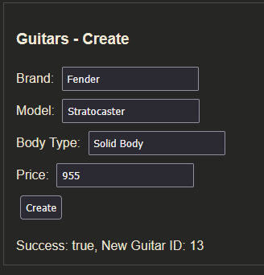
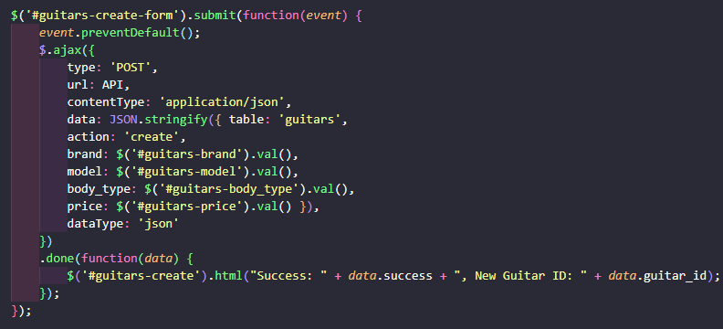
Client ajax
HTML with jQuery
Sends request in background (async)
Packages JSON object to post to API
.done writes result

Slide 9
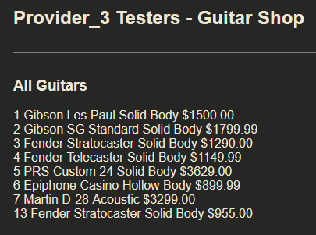
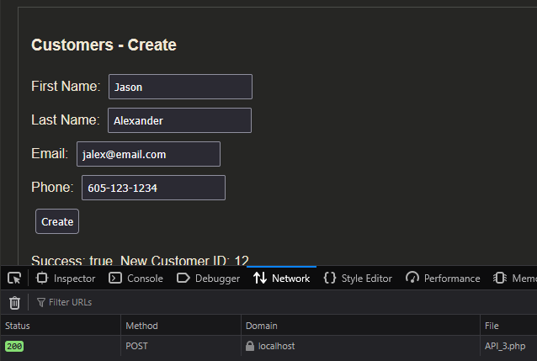
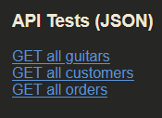
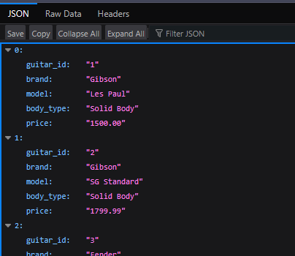
Debugging
Use built in testers
View raw API response
Blank page or errors show problems with PHP
Check DevTools in the browser

